Slide 1
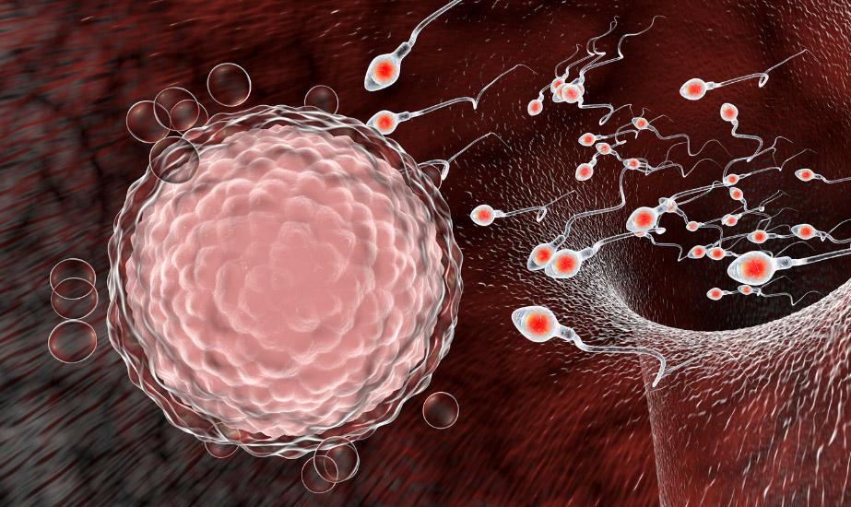

Fertility in Developed and Developing Countries
Group 8:
Saba Alaeddini, Vidushi Bundhooa, Aidan David

Slide 2
How do fertility rates differ in developed vs developing countries?
- We considered countries to be those with a GDP per capita of more than 12,000 USD to be 'developed', otherwise they are 'developing'.
- Fertility rate is the average amount of children that a woman in a given country is expected to have; thus, if the fertility rate is 4, that means the average woman gives birth to 4 children.
- We hope to prove that there is a correlation between the development (GDP per capita), and the fertility of a given country. Particularly, that it will be an negative correlation where the increase in GDP leads to the decrease in fertility rates.

Slide 3
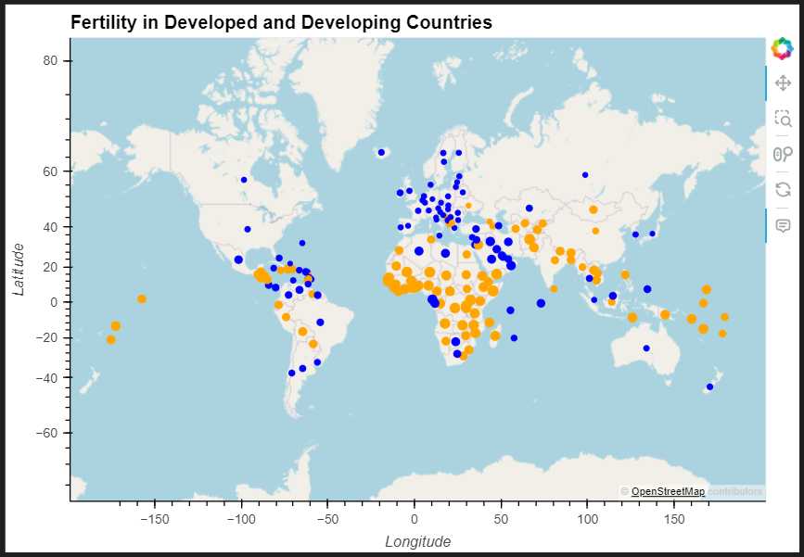
How do fertility rates differ in developed vs developing countries? - Visualization 1

Slide 4
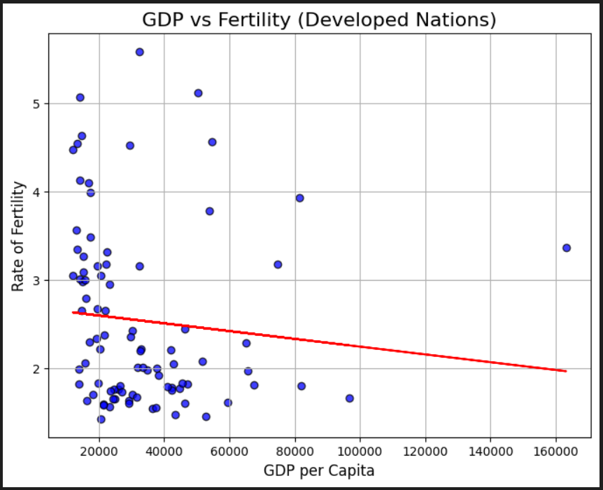
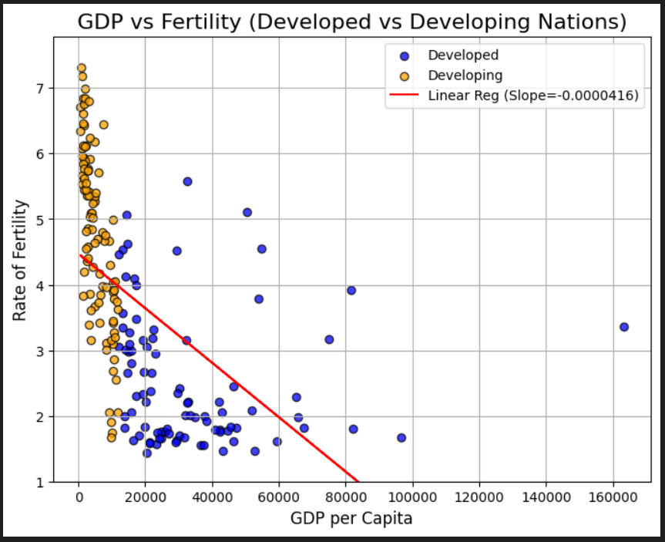
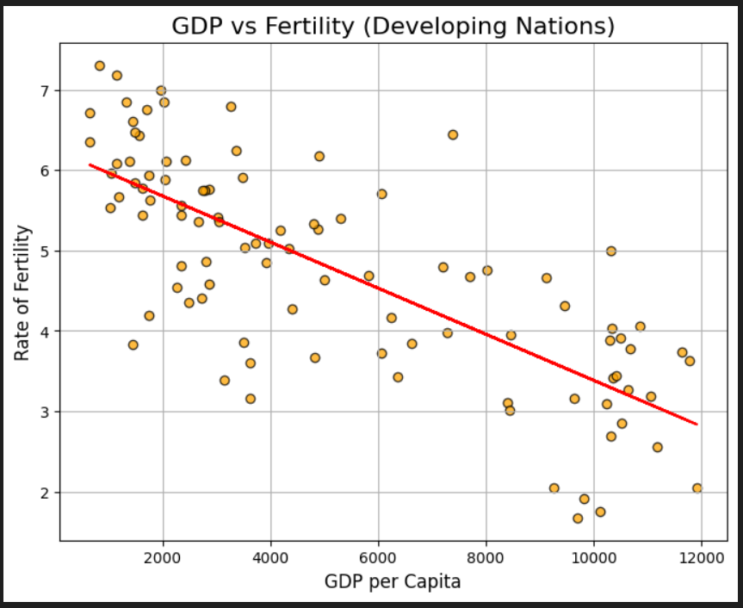
How do fertility rates differ in developed vs developing countries? - Visualization 2

Slide 5
How do fertility rates differ in developed vs developing countries? - Analysis
There is a clear correlation in both developed and developing countries where there is an increase in GDP per Capita, you see a decrease in the rate of fertility. That is to say, in general, that citizens of more developed and wealthy countries tend to have fewer children than citizens of less developed and less wealthy countries. The difference in fertility is most apparent amongst developing countries. Countries with GDP per capitas near the development boundary of 12,000 USD, have fertility rates (~2 to 4) dramatically lower than those at the very bottom of the global GDP valuations (~5 to 7). The Pearson correlation value (-0.5371), as well as the P-value (0.0000000000000023), both demonstrate a clear negative correlation between fertility and GDP per capita (development).

Slide 6
How prevalent are contraceptives in developed vs developing countries?
This analysis investigates the prevalence of contraceptive use in developed versus developing countries, with the aim of evaluating our hypothesis that there is a significant difference in contraceptive utilization between these two country groups.
Null Hypothesis (H0): There is no significant difference in the means of contraceptive methods' popularity or effectiveness between developing and developed countries.
Alternative Hypothesis (H1): There is a significant difference in the means of contraceptive methods' popularity or effectiveness between developing and developed countries.

Slide 7
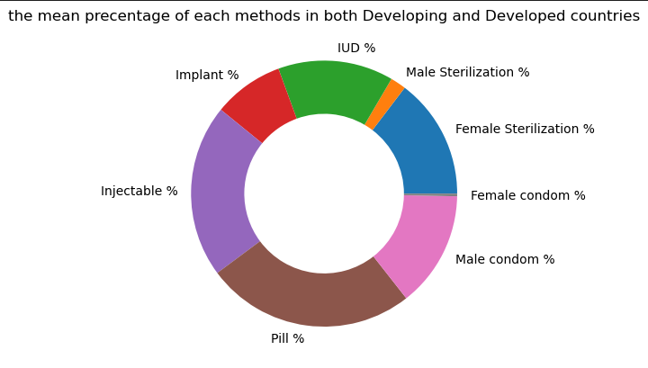
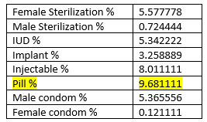
How prevalent are contraceptives in developed vs developing countries?-Analysis & Visualization 1
F-statistic: 22.05155597911754
P-value: 4.630506206795897e-27

Slide 8
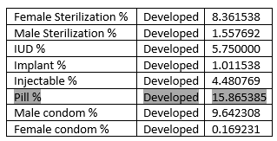
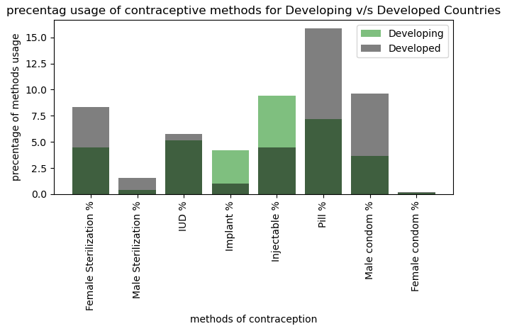
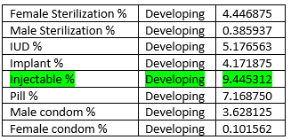
How prevalent are contraceptives in developed vs developing countries?-Analysis & Visualization 2

Slide 9
How prevalent are contraceptives in developed vs developing countries?-Analysis
Regarding to the tests that have been done like ANOVA, and based on F-statistic: 22.05155597911754 and P-value: 4.630506206795897e-27 results we can conclude:
*F-statistic of 22.05 suggests that there is a strong likelihood that at least one of the group means is significantly different from the others.
*p-value of 4.630506206795897e-27 is much smaller than the standard significance levels of 0.05 or 0.01. This means that there is an extremely small probability (practically negligible) that the observed result occurred by chance under the assumption that the null hypothesis is true. In other words, we can confidently reject the null hypothesis and conclude that there is a statistically significant difference between the means of the groups being compared.
As we can see in the bar chart and also the numerical value of the means for each method in developing and developed countries, we can conclude that the Pill with average usage of 15.86% is the most common contraceptive method in developed countries, on the other hand, in the developing countries Injectable method with average usage of 9.44% is the most common one

Slide 10
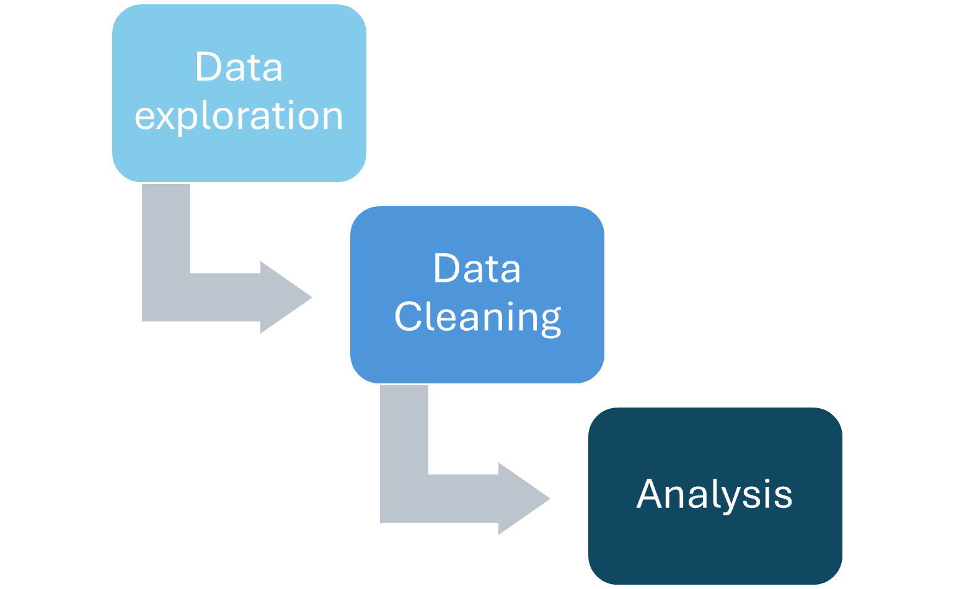


How do ages of conception differ in developed vs developing countries?
Is there a correlation between mean age groups and fertility rate?
Is fertility rate higher in developing countries than in developed countries?

Slide 11
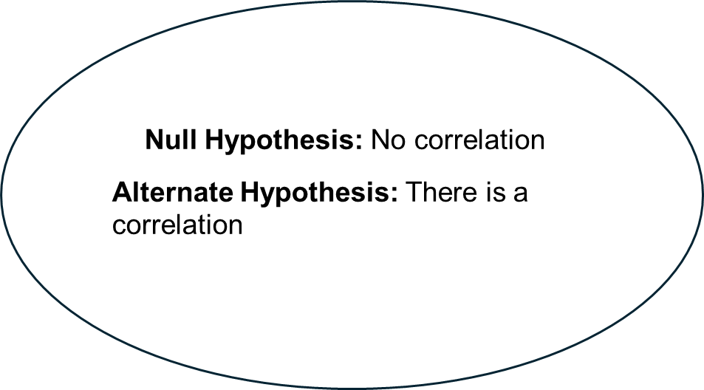
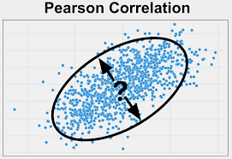

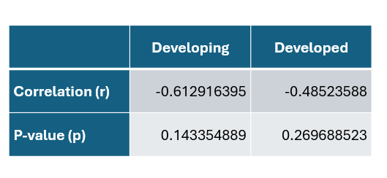
Is there a correlation between mean age groups and fertility rate?

Slide 12
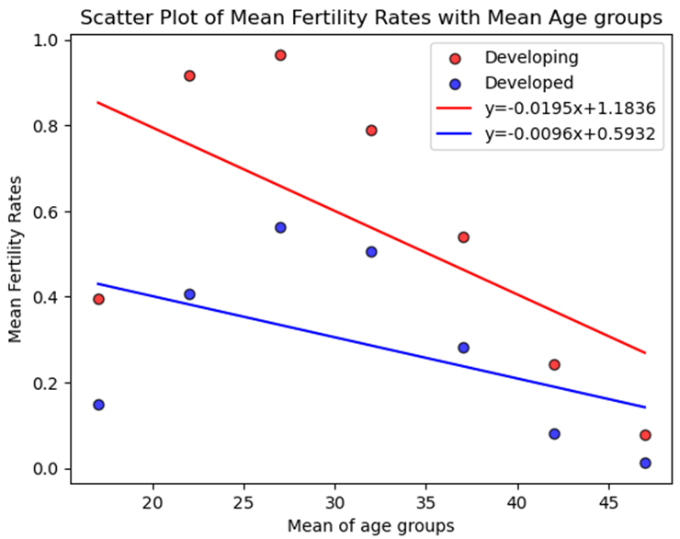
Is there a correlation between mean age groups and fertility rate?

Slide 13
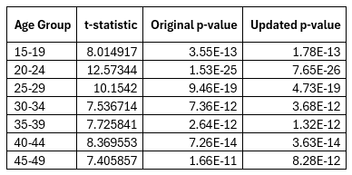

Is fertility rate higher in developing countries than in developed countries?
Null Hypothesis: There is a no difference between the means of fertility rates for developing and developed countries
Alternate Hypothesis : The mean of fertility rates is greater for developing countries than developed countries.
Independent Sample t-test

Slide 14
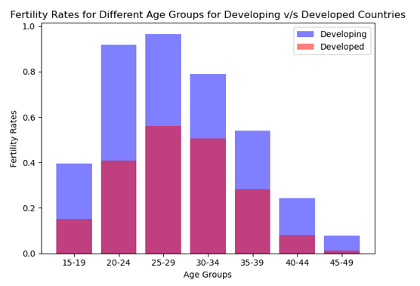
Grouped bar chart (overlayed)

Slide 15
Conclusion
QUESTION 1: There is a clear negative correlation that an increase in a country's GDP (development), leads to a decrease in its fertility rate.
QUESTION 2: According to obtained values, in developed countries, Pill with average usage of 15.86% is the most common contraceptive method. Where as, in the developing countries Injectable method with average usage of 9.44% is the most common one.
QUESTION 3: There is not enough evidence to support that there is a significant relationship between age group and fertility rates in both developed and developing countries. We have strong evidence that the means of fertility rates is greater for developing countries than developed countries.

